Slide 1
The Evolution of India's Credit Card
Ecosystem: Usage Patterns and Market
Structure
Sanway Sen and Aryaa Banerjee
PG-1st Semester

Slide 2
Introduction
In the post-independence decades, formal credit systems expanded through public-sector banks to promote financial inclusion and rural development.
The nationalization of major banks in 1969 marked a pivotal step toward democratizing access to credit facilities, while the 1980s and 1990s ushered in an era of liberalized markets that encouraged consumer credit growth.
Since 2000, credit card adoption in India has surged from a niche luxury product into a mainstream financial tool, underpinned by economic liberalization, fintech innovation, and the shift toward digital payments.
India's payments industry underwent a revolutionary shift post 2014, primarily due to the JAM: Jan Dhan, Aadhaar, and Mobile.
This Financial Inclusion campaign by the Government of India initiated in 2014, brought a massive number of people into the formal banking system. Gradually, the introduction of mobile-app based real-time payment system-UPI emerged as India's leading payment platform.
Amidst all these India's credit card market has experienced significant growth in recent years, with over 111.6 million cards in circulation and growing adoption among urban consumers.

Slide 3
Research Question
The paper seeks to look into the changing consumer behaviour in recent times in light of expanding credit markets in a developing country like India.
This study explores three primary questions:
      What are the patterns of credit card usage over the years in India?
      What insights can we draw from the comparison of Credit Card and Debit Card expenditure?
      Who are the major card issuers, and how do they compete for market share?
To answer these questions, we have used publicly available data from RBI and NPCI, mostly using the monthly card statistics data available on the RBI website.
A key constraint is the limited availability of detailed consumption data broken down by demographic segments and geographic regions, necessitating the use of transactional value and volume data only.

Slide 4
Credit Card usage trends
There has been significant expansion in credit card usage throughout our study period (2011-2025).
Post 2016, demonetization and the shift to “digital economy” led to a steep rise in the use of credit cards.
The number of credit cards issued at the end of July 2024 was 11.16 crores, which was just around 1.76 crores in 2011.
The growth rate of credit card usage has increased by 15% in terms of the number of transactions. In terms of the amount spent, credit cards have shown a robust increase of 24%.
These figures suggest a growing preference for credit cards among Indian consumers, both in terms of usage frequency and spending volume because high-value purchases are increasingly made via EMIs and structured credit options.

Slide 5
Debit Card or Credit Card?
Traditionally, Indian consumers were more inclined towards using debit cards, viewing debt as a “taboo”.
In April 2023, credit card transactions surpassed debit cards' volume, indicating a crucial moment in India's payment dynamics.
By July 2025, credit card transactions volume reached 24.32 crore compared to 8.32 crore for debit cards, marking a significant reversal in consumer behaviour patterns.
This can be linked with the expansion of e-commerce platforms, which is widely growing as the first choice for consumers. It can be a major factor in credit card use as credit is an easy payment option.
This has also resulted in declining trend in the usage of debit cards at POS.

Slide 6
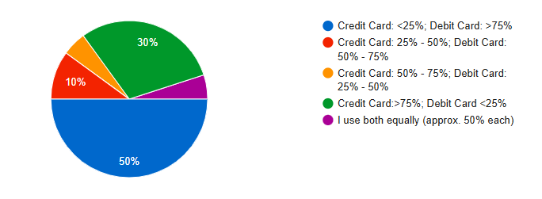
Debit Card or Credit Card?
In comparison of credit cards with debit cards, it is evident from the figure that the value of Credit card transactions are always more than debit card transactions.
This justifies people’s preference of credit cards for purchasing high value and luxury items on credit.
Although most users (50%) rely more on debit cards, credit cards account for a higher total transaction value, meaning fewer people make larger purchases with credit cards.
This highlights the low credit card penetration in a country like India, where credit card users are mostly based in Tier-1 and Tier-2 cities.

Slide 7
E-commerce and Co-branded Credit Cards
The recent surge in credit card usage also links to the advent of e-commerce facilities and the growing simplicity of easy consumer loans.
With limited data available, we see that Credit Card spending have been always preferred to Debit Card because of the benefits and reward programs associated with it.
Further the introduction of co-branded credit cards like the ‘Amazon ICICI Bank Credit Card’ or the ‘Flipkart Axis Bank Credit Card’ seeks to ensure consumer loyalty by extending easy consumer loan options like No-Cost EMIs.
Additionally, users are drawn to the functionality, convenience and security features of credit cards which drive their widespread acceptance in India’s rapidly digitizing economy.

Slide 8
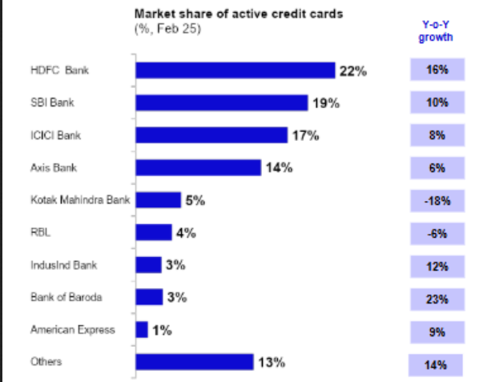
Structure of Credit Card Market
India’s credit-card market is led by HDFC, SBI, ICICI, and Axis — together steering industry growth through digital innovation, co-branding, and expanding urban demand.
The Credit Card market continues double-digit expansion driven by urban consumption and digital payments.
Digital onboarding, fintech tie-ups, UPI-linked credit-cards are emerging features which lead private sector banks to capture a major portion of the credit card market.
The year-on-year growth also shows aggressive expansion of the credit market.
Data from economic times
Notes:
The graph alongside shows the active card count and YoY growth of major credit card issuers in India.
HHI =
22² + 19² + 17² + 14² + 5² + 4² + 3² + 3² + 1² + 13²
= 484 + 361 + 289 + 196 + 25 + 16 + 9 + 9 + 1 + 169
= 1,559

Slide 9
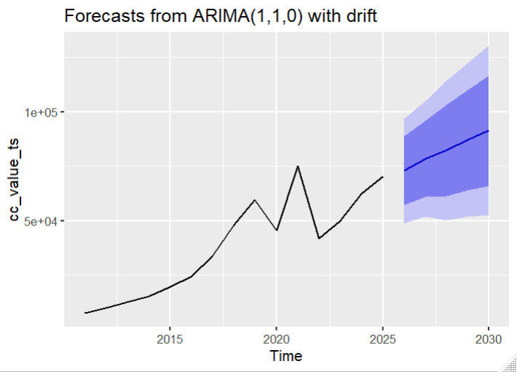
Forecasts
The number of Credit Cards issued is predicted to rise to 16.3 crores in 2030, up from 11.16 crores in 2025.
This rise in usage can be justified by the innovations and aggressive competition between Credit Card companies, which makes it easier to access credit cards.
Total value of credit card transactions is also projected to rise to 91340.62 crores in 2030 from 70380.31 crores in 2025, an increase of approximately 30%.
As more and more luxury goods offer Easy Monthly Instalments (EMIs) through credit cards, the value of transactions is likely to increase in line with forecasted values.

Slide 10
Findings
With the expansion of the credit market and the introduction of UPI as a hassle-free method of payments, along with the growth in e-commerce fuelled by credit cards, we find that there has been a shift in the debit card usage pattern.
We notice a 8.4% annualised reduction in debit card usage volume since 2019 as is shown by the graph.
A Chow Test was run on this data to examine whether the growth pattern exhibited a structural change in 2020.
The test yielded F=5.09, p-value=0.0299, indicating a statistically significant break.
Notes:
Since 2019, the widespread adoption of UPI along with the growth in e-commerce "online shopping" fuelled by credit cards have led to a fall in debit card usage
Debit card PoS growth was driven by formalization & acceptance expansion (pre-2019); post-2019 decline reflects pandemic impact and migration of low-value payments to UPI and changing merchant/consumer preferences.
Last point: This is suggestive of the idea that the YoY growth in debit card transactions, experienced a structural shift in following 2020, consistent with the onset of the COVID pandemic and the concurrent acceleration of UPI-based payments.

Slide 11
Policy Implications
This surge in credit card growth over the recent years give rise to serious policy implications. Through this paper, we aim to highlight a few which seemed most concerning:
Debt-resolution & recovery frameworks: With growing unsecured exposures, regulators should ensure effective, fair restructuring frameworks and strengthen credit-counselling/insolvency support for over-indebted consumers.
Competition & market structure: Oligopolistic concentration (top private banks dominating) risks reduced competitive pressure on fees/rewards. Regulator should monitor interchange, co-brand exclusivity clauses, and facilitate entry of new issuers/platforms.
Consumer protection & disclosure: Surge in credit usage increases the need for clear, standardized disclosure of interest rates, fees, EMI terms and late-fee mechanics.
Financial inclusion trade-offs: Credit growth is concentrated in urban tiers; targeted policies are needed for responsible rural credit expansion to avoid exclusion or predatory offers.
Policy coordination: Explicit guidelines for credit card schemes like buy-now-pay-later and co-branded EMI products (disclosures, caps, reporting) to prevent regulatory arbitrage.

Slide 12
Conclusion
From Central Bank of India’s first credit card in 1980 to today’s digital credit cards on UPI technology, the Indian credit card market has evolved leaps and bounds.
Across both online and physical retail transactions, consumers consistently exhibit higher average spending when using Credit cards compared to Debit cards, highlighting a clear preference for Credit cards in higher-value purchases.
This leads to a question of whether easy consumer credit options really help in expanding the economy by boosting consumption or creates a credit bubble due to lack of adequate collaterals to back loans?
The data and forecasts however fail to highlight a major section of the developing rural section of India, as credit card penetration is very low in the rural sector.
While in developed nations like the USA, people use credit cards extensively, the credit market in India is yet to reach a level where at least half of the population holds a credit card.
However, the credit card market in India is expected to expand further, and with proper policy decisions and implementations of stricter norms, this growth can be made inclusive, thereby narrowing the inequality gap.

